Slide 1
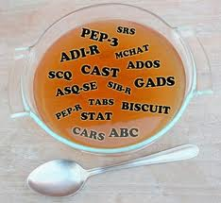
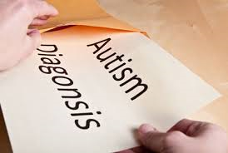
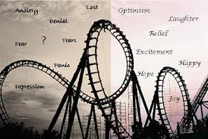
Parental Perception of The Transdisciplinary Neurodevelopmental Diagnostic Team Evaluation Process
Principal Investigator Eric Albers Ph.D., Co-Investigators Carol Broersma MSW and Jan Marson OTD
Nevada Leadership Education in
Neurodevelopmental Disabilities
Stephen L. Rock, Ph.D. , Director
University of Nevada-Reno, School of Medicine, University Center for Autism and Neurodevelopment
Introduction
Parental Reaction To Identifying Children with Autism Spectrum Disorders….The Discussion
Scientific Rationale
The University Center for Autism and Neurodevelopmental Disorders (UCAN) group, which is housed in the Department of Speech and Audiology based at the University of Nevada School of Medicine is a clinical multi-disciplinary team comprised of professionals from a variety of disciplines including speech pathology, occupational therapy, developmental pediatrics, child psychiatry, psychology, and special education. The team utilizes a "gold standard" assessment instrument, the Autism Diagnostic Observation Schedule (ADOS), as the primary tool in determining whether or not a child meets criteria for autism. Parent(s) of the child are included during the assessment process. Due to the sensitivity of assigning or not assigning a diagnosis on a child as well as being provided a list of potential referrals to community agencies responsible for early intervention and early childhood special education, parent(s) will react from a variety of possible ways.
In that the process of parent(s) of a child being assessed for autism can be anxiety provoking with a multitude of emotional responses occurring and with the focus being primarily focused on the well-being of the child, this research project identifies how the parent(s) themselves are effected by this experience thereby understanding how better to provide a family comprehensive intervention approach. The purpose of this study is to understand the experience of parents prior, during, and after an assessment had been conducted with their child being either diagnosed or not diagnosed with autism.
At the time of diagnosis……
“When I first found out (he had autism), I was pretty upset. I cried for three weeks.”
“After I received the diagnosis, I was shocked. Because like I said I was hoping there was nothing wrong, there was something simple. But when they told me he was on the spectrum, I started reading books and this and that. Inside my mind I made him more feebler than he was. But once he started receiving therapy, he responded very well to therapy.”
“I was very concerned about my son. Not knowing what exactly he would be …a category. I wasn’t in denial that something was possibly different about him but ....frightened about his future.”
“Hopeful...I would say, I was a little apprehensive but hopeful during the process. Apprehensive that maybe that something might be different about my child and hopeful to help him.”
“I knew my son had autism, but when they told me there is a good treatment for him. I was so happy to start to help my son.”
After the diagnosis……
“Now that we had a diagnosis, I was more hopeful that we could get him some help.”
“I felt like I’d been dropped off a cliff…alone.”
“Some of my friends and family too, said they didn’t think he had it because he can do some things. I tried to tell them it’s a routine he knows so he’ll do it. So there’s kinda a little bit of denial.”
“I was pretty much overwhelmed by all the information that was given to me. It was almost like I couldn’t process it all and even now I didn’t use half the stuff they gave me. All the programs and groups, and paperwork to fill out.”
“English is my second language. It was hard because some of the organizations did not understand me and I did not understand them. And some of the organizations too, they put me on waiting lists for long time because I do not know the process. Other organizations denied us…many. I didn’t get any help the first month until UCAN helped me.”
Going through the Diagnostic Team Evaluation Process…..
“My experience was good… was very helpful. They (the transdisciplinary team) opened many doors for me and my son.”
“When I came to UCAN they said exactly what my son has and they did a lot of recommendations and helped me in everything.”
“I felt everyone was open to hearing everyone else’s opinions and suggestions, and I think there were good ones.”
Results
For more information, contact:
Eric Albers, Ph.D.
Principal Investigator
School of Social Work, Division of Health Services
University of Nevada, Reno
Office: (775) 682-8711
e-mail: erica@unr.edu

